Slide 1

A quarter century later:
Canada’s tobacco lawsuits
Cynthia Callard
Physicians for a Smoke-Free Canada
March 2025

Slide 2
Outline
Canadian tobacco lawsuits since 1998
The impact of insolvency protection (CCAA) & the “Plan of Compromise”
Notes:
2. A lot has happened in the past quarter century. This morning I want to briefly cover the chronology events and talk in a bit more depth about two historic elements: the lengthy trial in Quebec and the global settlement that has been reached.

Slide 3
For decades, tobacco control advocates have supported tobacco litigation
Encouraged governments to file suits
Assisted governments and other legal teams in developing their cases
Promoted tobacco litigation as a way to:
  Seek justice against wrongdoings
  Provide compensation to smokers
  Provide compensation to taxpayer
  Expose industry behaviour (through publicity of trials)
  Set higher standards for tobacco (and other manufacturers)
  Protect future generations
Included liability as a measure in the FCTC (Article 19).
Notes:
3. Since the 1970s tobacco control groups have wanted tobacco companies to be held to account in courts of law. This seemed like a logical way to hold them to account for the wrongs they had done and to provide some compensation to those who had been injured. We also expected that the justice system could help expose the wrongdoing of the companies in ways which would prevent these bad behaviours from being repeated. The inclusion of civil liability in the framework Convention on Tobacco Control illustrates the expectation that lawsuits were a tobacco control intervention.

Slide 4
More tobacco lawsuits filed in Canada than in any other country outside USA.
All 10 provinces sued to recover costs of treating tobacco-caused disease
  Health-care delivery responsibility of provincial governments (federal government has not claimed)
  Claims originally in excess of CAD 500 billion for damages dating from mid 20th century
3 Class action suits authorized:
  2 Quebec claims related to addiction and lung cancer, COPD and certain cancers (Blais and Létourneau)
  1 B.C. claim related to “light” cigarettes (Knight)
  Also several “copy-cat” lawsuits filed in each province
  (Also suit filed by farmers regarding contract breach)
Notes:
4. As it turns out, Canada is one of the few countries outside of the united states where tobacco lawsuits took place. I am not sure of the statistics this year, but over the past two decades more than half of the world’s lawsuits were being held in Canada.

Slide 5

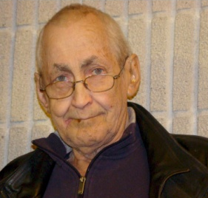


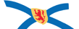





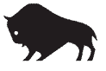

Canadian Tobacco Litigation Timeline
Létourneau filed
Sep 10, 1998
Class Actions
May 2003 Knights ‘light’ cigarette class action filed
Nov 2016
Appeal Hearing
Aug 2012
JY Blais dies
Mar 1, 2019
Quebec Court of Appeal Decision
Feb 2005
Quebec class actions authorized; Knight action certified.
May 27 2015: Quebec Superior Court Ruling
JY Blais suit filed
Nov 18, 1998
Mar 2012
Hearings begin
Dec 2014
Hearings end
STOP
March 2019
Insolvency protection granted and all litigation stayed.
January 1995: Caputo filed
Feb 2004: Caputo disallowed
1995 |  |  | 1998 | 1999 | 2000 | 2001 | 2002 | 2003 | 2004 | 2005 | 2006 | 2007 | 2008 | 2009 | 2010 | 2011 | 2012 | 2013 | 2014 | 2015 | 2016 | 2017 | 2018 | 20 | 19 | 2020 | 2021
2015: Nova Scotia files suit
2008: New Brunswick files suit
2011: Newfoundland Labrador files suit
NS 2015
Provincial Cost-recovery
BC filed
November 1998
2001: BC revises law and re-submits lawsuit.
2000: BC tobacco litigation law struck down
2012: Prince Edward Island, Saskatchewan, Alberta, Manitoba, Quebec file suit
2009: Ontario
files suit
Notes:
5. Aside from a handful of unsuccessful individual cases, there were two main categories of large suits filed against the companies – class actions filed on behalf of individual smokers and cost recovery suits filed by provinces. There were class actions filed which are now shown here – some were rejected and some never moved beyond the initial filing state. History sifted out all but 3 class actions: two of them were in Qeubec – one for addiction and one for lung cancer, throat cancer and emphysema. Those were combined for trial purpose and ultimately the lawfirms managing them merged the cases and their practices. The other, much smaller case, was the Knight case in British Columbia which addressed the deceptiveness of selling “light” cigarettes. With respect to provincial lawsuit s—B.C. was the forerunner – it took 7 years or more before another province joind in the effort and 7 years after that before all provinces were on board. Among these, the only case to go to trial were the Quebec class actions.

Slide 6
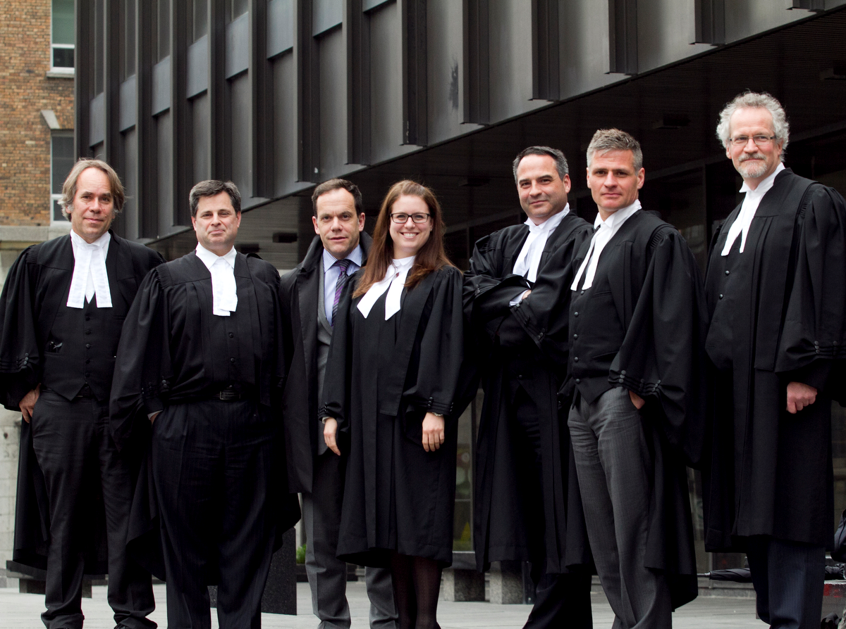

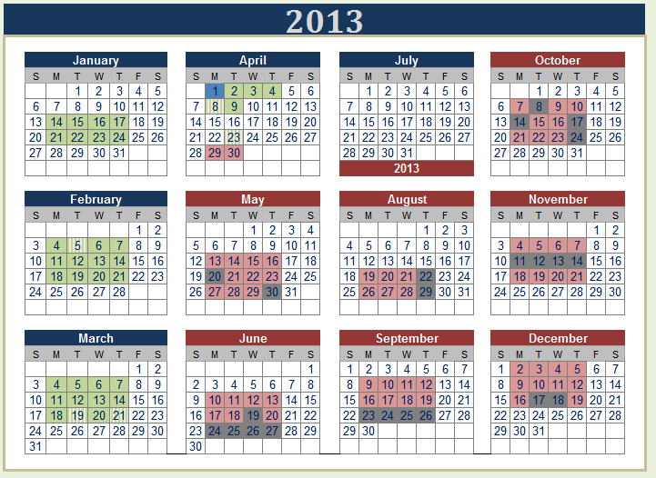
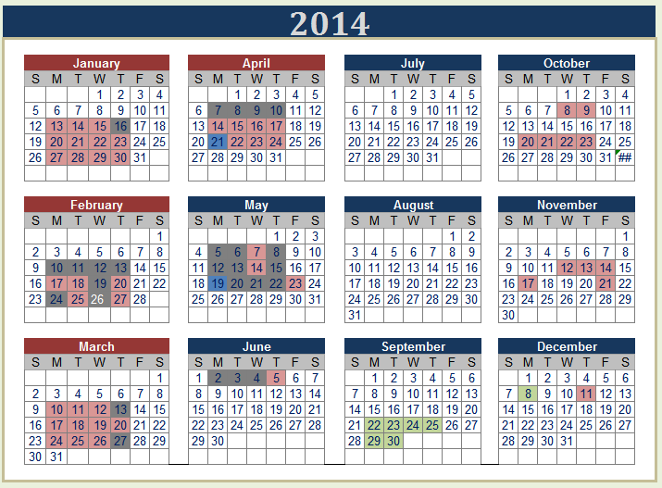
Quebec: Conditions for tobacco class action uniquely in place.
Civil law culture
Contingency fees permitted
Class actions well-established, authorization easier
Fonds d’aide provides financial support to class actions in public interest
2009 Tobacco-related Damages and Health Care Costs Recovery Act
  permits statistical (epidemiological) proof
  removes time limits on claims
Law firms willing to take the risk
Pierre Boivin
Gabrielle Gagné
Bruce
Johnston
André Lespérance
Michel
Bélanger
Marc Beauchemin
Philippe Trudel
Notes:
6. So why Quebec? There were conditions uniquely in place in Qeubec which aided a case of this magnitude and risk taking place. These included their civil culture and its greater acceptance of class actions, and financial support that is given for special costs of lawsuit that are seen to be in the public interest. In addition, when the Quebec government passed legislation to facilitate its own lawsuit, it included the use of statistical evidence for class actions as well. Most importantly, there was a group of lawyers ambitious enough to take the case on.

Slide 7
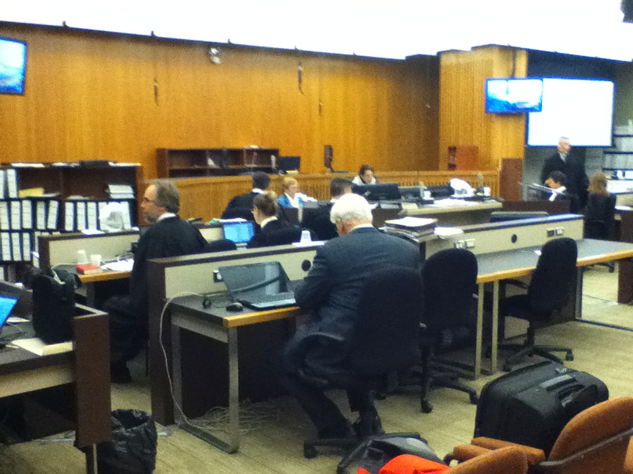
One of the biggest Canadian trials in history looked at 5 decades of tobacco industry behaviour
Quebec claims tried together in Quebec Superior Court by Justice Brian Riordan.
  33 months:
    March 2, 2012 to December 11, 2014
  250+ days of hearings
    72 witnesses
    42,000 exhibits
  30+ interlocutory appeals
Notes:
7. It took around 13 years for the case to come to trial. It was one of Canada’s longest and largest trials – 250+ days of hearing, 72 witnesses, and dozens of times when the Appeal Court was asked to rule on issues mid-trial. The 42,000 exhibits that were registered in the court can be found on the Legacy website of tobacco documents. I took that picture from the corner where I and my colleague Pierre Croteau sat and wrote a story to post online each night at the end of the day’s events. Mine in English and his in French. This work was supported by the Quebec Ministry of Health as a way to share information on the trial with the world.

Slide 8

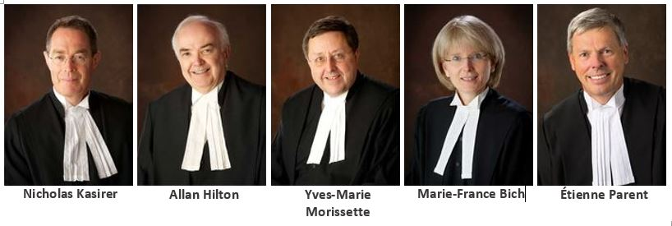
6 judges unanimously agreed: smokers were harmed because tobacco companies broke the law.
Quebec Superior Court
May 27, 2015
2015 QCCS 2382
Victory #1
Brian Riordan
Victory #2
Quebec Court of Appeal
March 1, 2019
2019 QCCA 358
Notes:
8. The two Quebec rulings on this case were a massive victory for the Quebec team and a stunning loss for the companies. Justice Riordan’s ruling, issued in 2015, used strong language in condemning the companies for their egregious behaviour. That decision was taken to the Appeal Court, which heard arguments in late 2016 – and then took a long time to make its decision. I ran into a lawyer for one of the tobacco companies in a train station in late 2018 and he said confidently to me that Appeal Courts do not take a long time to agree with a judge. But when their ruling was issued on March 1, 2019 it was another stunning victory. Other than a tweaking of an interest rate calculation, they essentially upheld the entire judgement and did more. Very unusually, they went into the evidence in the trial and buttressed their decision by citing additional documents and by answering further potential legal questions.

Slide 9
The companies broke 4 Quebec laws.
They were ordered to pay $13+ billion in compensation to 100,000 injured Quebec smokers.
failure to inform the public health authorities or the public directly about the health effects of smoking;
Knowingly making false and incomplete public statements about the risks and dangers of smoking;
false or misleading representations, as manufacturers or advertisers, to consumers by giving the general impression that smoking was not harmful to health.
lobbying to keep knowingly incomplete and insufficient warnings placed on cigarette packages;
collusion among themselves and other tobacco manufacturers in order to impede the public from learning of health-related information about smoking;
unlawful interference with the right to life, security and integrity of the Quebec Victims;
failure, as manufacturers or advertisers, to mention an important fact in representations made to consumers; and
false or misleading representations, as manufacturers or advertisers, to consumers by giving the general impression that smoking was not harmful to health.
Notes:
9. These rulings specified the four Quebec laws that were broken – the two Civil Codes in place during the period under review and their requirement son manufacturers to warn, the Consumer Protection Act, and the Quebec Charter of Rights and Freedoms. Within these rulings are criteria for how companies selling harmful products – tobacco, alcohol, nicotine, cannabis – should behave.

Slide 10
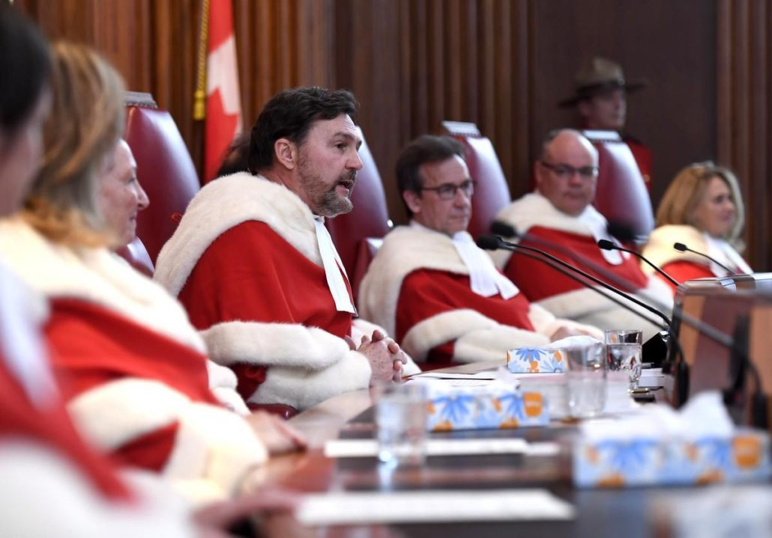
What was expected to happen next…
Before Appeal Court ruling released, it had been expected that who ever lost that decision would appeal to the Supreme Court.
SCC has final authority on Canadian cases
There is no automatic right of appeal, the SCC decides which cases it will review.
Strength of Appeal Court ruling made it more likely that SCC would not hear the case or would not reverse the decision.
Notes:
10. In March 2019 what would normally have been expected was that the companies would try to go to the last Court of Appeal. That’s not what happened.

Slide 11
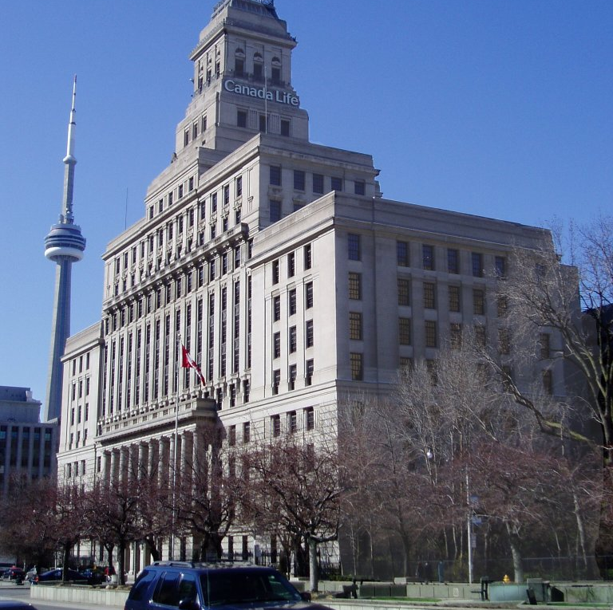
What happened instead….
Companies filed for insolvency protection in Ontario courts
The Companies’ Creditors Arrangement Act (CCAA) a federal law designed to prevent bankruptcy
Suspends all claims to allow companies to make an arrangement with their creditors
All lawsuits against tobacco companies suspended from 2019 to now.
Provincial governments agreed to CCAA process
  Prevented finalizing Quebec case, and paying smokers
  Court order explicitly permits “business as usual” during protection
Ontario Court appointed a mediator
Top secret negotiations underway from 2019 to 2024
Notes:
11. Instead, the companies played a trump card. They filed for insolency protection in an Ontario court. They said they wanted to negotiate a global settlement and finalize all of the lawsuits against them. In many ways this had the effect of pitting the provinces against the Quebec smokers who had won a court victory. Neither would the Quebec smokers get their compensation, nor would they have a chance to win in the Supreme Court. The insolvency process suspended the progress of all litigation. The Quebec victims compensation was now in competition with the provinces claims for a slice of whatever size of pie the companies were able to provide.

Slide 12

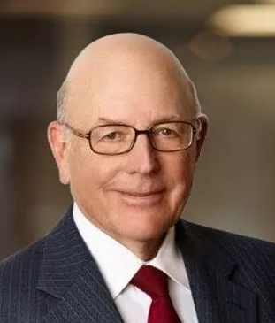
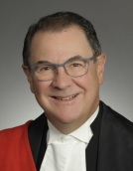
March 6, 2025
APPROVED
Justice McEwen
Former Chief Justice Warren Winkler, Mediator
Chief Justice Morawetz
2019 |  | 2020 |  | 2021 |  | 2022 |  | 2023 |  | 2024 |  | 2025
March | Sept | March | Sept | March | Sept | March | Sept | March | Sept | March | Sept
Mar 8, 12 and 22 JTI, ITL and RBH granted CCAA
JULY 2023 – NEW JUDGE
Oct 2023 – Mediator mandated to draft plan
Oct 2024
Draft plan made public
Jan – Mar 2025
SANCTION HEARINGs
April – Extended to June 2019
Dec 2024
VOTE ON PLAN
March - Extended to Sept 2020
March - Extended to Sept 2021
March - Extended to Sept 2022
March - Extended to Sept 2023
March - Extended to Oct 2024
June – Extended to Oct 2019
Sept - Extended to March 2021
Sept - Extended to March 2022
Sept - Extended to March 2023
Oct - Extended to March 2024
Oct to Jan – extended to next steps
Oct – Extended to Mar 2020
The CCAA Timeline
Notes:
12. Six more years get added to our timeline. Instead of an open court, the negotiating process ordered by courts was highly secretive. The process seemed to be entirely in the hands of the judge in charge and of the man who had been appointed as mediator – Warren Winkler. Warren Winkler – more properly the Hon. Warren Winkler, former Chief Justice of the Ontario Superior Court – was no stranger to tobacco litigation. He was the same judge who had refused to certify the first class action case – the Caputo case - in Ontario in 2004. For 5 years the whole thing went underground, surfacing only every 6 months for a brief court ruling and a rubber stamp on the request for a further extension. The Quebec lawyers made several appeals and protests against the delays, but these were all rebuffed and sometimes they were chastised for raising concerns.
CLICK
That changed in the summer of 2023. Justice McEwen, who had supervised the process, retired. The man who replaced him on the file was the Chief Justice in Ontario, Geoffrey Morawetz. He presided over his first hearing in early October that year. The Quebec plaintiffs were again raising concerns about the lack of progress and spirit of the negotiations. This time, this judge took matters into his own hands. He asked each of the companies what they were going to do to address the delay – and when none of them provided him with a meaningful answer – he took the responsibility for coming up with a settlement plan out of their hands. He ordered the mediator and the accounting firms assigned to the case to draft a plan.

Slide 13
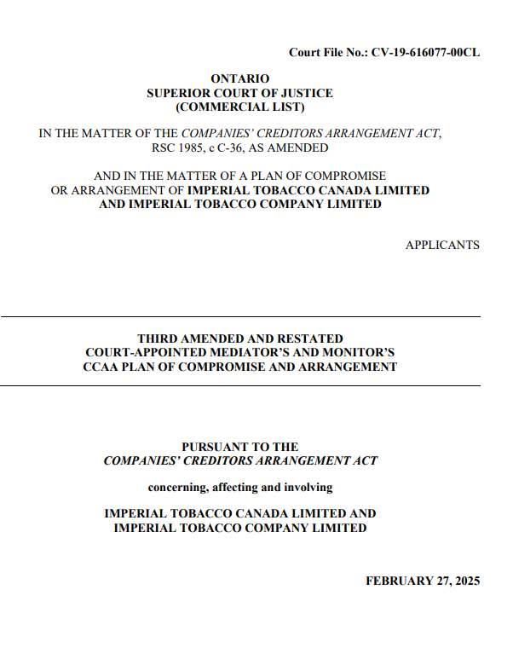
The Plans:
1,300-ish pages
* 134 pages of terms
* 24 Schedules
3 near-identical plans for each company
Notes:
13. One year late r- last October – that plan was made public. In December it was voted on by the provinces and others suing the companies. In January and February the fairness and reasonableness of the plan was presented to the courts and in March it received court approval.

Slide 14
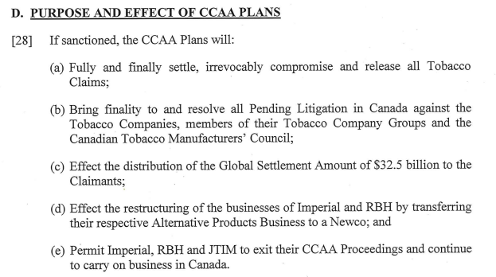
The CCAA
“Plan of Compromise”
Chief Justice Morawetz. Sanction Order, 6 March 2025
http://cfcanada.fticonsulting.com/ImperialTobacco/docs/FINAL-Tobacco-ONSC%201358-A.pdf
Notes:
14. So What does this plan do? The hint is in the title – it is a plan of compromise. This resolution will end all tobacco claims for harms incurred up to the point it takes effect – including claims to the multinational owners. In order to do this, it created another synthetic class action which mirrored the compensation offered to the Quebec claimants. To address the majority of smokers who would receive no compensation, it established a research foundation aimed at providing them with improved treatment options for their injuries. It will provide $32.5 billion in compensation. About $20 billion of that is dependent on future tobacco sales. Provincial governments will be paid a percentage of the earnings from tobacco sales until the $20 billion is paid off. For the first 5 years they will receive 85% of the earnings, after that it will be 80%, then 75% after a further 5 years, e,tc. The agreement separates the conventional tobacco business from vaping or alternative products – the companies will not have to use revenues from those products in their payments. It purposefully has the effect of ensuring that the companies did not go bankrupt or have to go into receivership as a result of the lawsuits.

Slide 15
$32.5 billion:
* $6.3 billion to smokers
* $1 billion for foundation
* $24.725 billion to provincial governments
* $135 million in other payments
*$13-ish billion paid immediately (from savings during CCAA)
* $20-ish billion to be paid in annual installments calculated as 85% of net revenue on tobacco sales (falling by 5% every 5 years to 70%)
* completion expected to take 20 or more years
Notes:
15. Let’s look at how the $32.5 billion pie was divided. About three quarters of the payments go to the provinces - $24.7 billion and one-quarter in compensation for individuals - $7.3 billion Individuals get virtually all of their money upfront. Provicnes get most of their money in annual payments

Slide 16
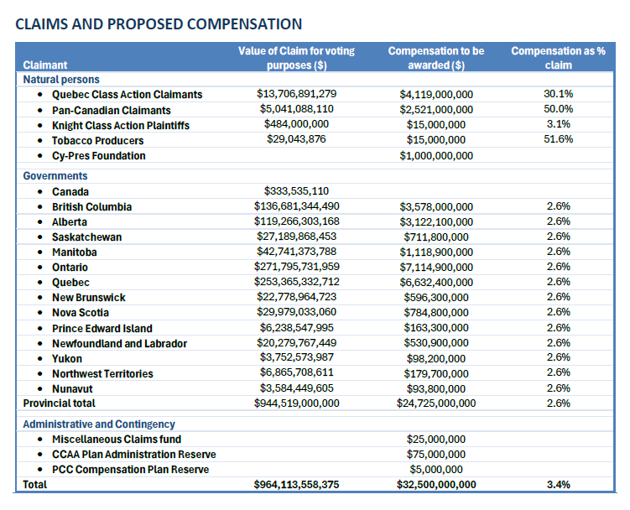
Compensation is a fraction of damage ..
3.4 cents on the dollar
Notes:
16. Nobody gets compensation anywhere near the harms they experienced. During the settlement discussions, a health economist was hired to calculate the amount of health care costs attributable to the wrongful actions of the companies in the last century, only using smoking that was initiated in that period. The total was $900 billion dollars. The provinces are getting only 2.6% of that amount
The Quebec class action had a court ruling of $13.7 billion, but are receiving $4.1 billion or 30%. The synthetic class action, using the same per-capita payments, would have been entitled to $5 billion, but get half as much. Overall, the companies paid 3.4 cents on the dollar of damages they caused.

Slide 17
WORLD
FIRST:
Collective damages to injured smokers
 | Quebec Class Action | Pan Canadian Claims
# people | 99,958 | 186,003
Smoking history | 12 pack years between January 1950 and November 1998
Diagnosed | Before March 12, 2012 | March 8, 2015 to March 8, 2019
Resident | Quebec | Canada
Alive on: | November 20, 1998 | March 8, 2019
Started smoking | > 1976 / ≤ 1976 | > 1976 / ≤ 1976
Lung Cancer | $80,000 / $100,000 | $48,000 / $60,000
Throat Cancer | $80,000 / $100,000 | $48,000 / $60,000
COPD Grade III-IV | $24,000 / $30,000 | $14,400 / $18,000
Registration: | recourstabac.com | tobaccoclaimscanada.ca
If there are more claimants than funding, payments will be reduced on a pro-rata basis.
Money left over after 12 months (QCAP) or 24 months (PCC) will be given to the provinces.
Notes:
17. How much will individuals get? The plan is expected to provide up to $100,000 for members of the Quebec class, and up to $60,000 for members of the Pan Canadian Class (which includes people in Quebec). There are strict eligibility requirements. The number of potential recipients is calculated at about 270,000 people, although the “take up” rate may result in a higher or lower number. If the number is higher, then the amounts awarded will be lower. The deaths of most of the one million Canadians who have died from tobacco disease in this century will not be compensated.

Slide 18
The financial reality:
The companies caused more harm than they can afford to pay for.
The claims and costs to government are big
  $13+ billion Quebec judgment
  $500+ billion provincial claims (initially)
  $900 billion as calculated by CCAA consultant
The assets are small
  2015: court ordered security of $ 885 million
  2019: CCAA stops revenues to owners, money reserved now worth $13 billion (ish)
The Canadian earnings are (relatively) small
  Annual earnings in Canada are about $2 billion a year
The multinational owners’ 2024 profits are about $45 billion per year.
  BAT: £2,736m in 2024 (CAD 5 billion)
  PMI: US $24 billion in 2024 (CAD 34 billion)
  JTI: JPY 697 billion in 2024 (CAD 6.7 billion)
Notes:
18. This is a good moment to point out that tobacco products have caused so much harm that it is not realistic or possible for them to compensate fully. The companies do not save their earning s—they distribute them to shareholders who are immune from compensation claims. Their earnings are large, but not in comparison to the health care costs they trigger. It’s an old mother hubbard situation – the cupboard is kept bare.

Slide 19
On average, compensation is comparable to:
* having raised tax revenues by 39% since suits filed
* having raised tax revenues by 27% over past 20 years
* upfront payment double tobacco tax revenues in 2023-24.
Notes:
19. It’s also worth comparing the new revenues the provicnes will be receiving with the revenues they already receive from the tobacco market in the form of taxes. On average, the compensation that will be paid to the provinces over the next 20 years is the same as if they had raised tax revenues by 27% over the last 20 years. The upfront payments they will soon receive are about double the revenues they got from tobacco taxes last year.

Slide 20
NOT INCLUDED in the compromise plan: measure to reduce tobacco use
ALL NGO REQUESTS AND SUGGESTIONS WERE REJECTED
REQUEST | RESPONSE
10% of settlement revenues to an independent fund to reduce tobacco use (1)(2) | X
Ending all remaining tobacco promotion (1)(2) | X
Requiring companies to make additional payments if targets to reduce tobacco use are not achieved (1) | X
Public disclosure of internal documents (1)(2) | X
End to interference with health policies (lobbying, PR, disinformation campaigns, etc) (2) | X
Reject settlement that perpetuates the tobacco industry (2) | X
Phase-out of combustible cigarettes, followed by phase out of non-licensed nicotine products (2) | X
Refuse to resolve lawsuits through CCAA court (2) | X
1. Canadian Cancer Society, Lung Association, Heart & Stroke. Open letter to provincial premiers. May 29, 2023. https://www.heartandstroke.ca/-/media/pdf-files/what-we-do/news/open-letter-to-premiers-tobacco-settlement-negotiations-2023-05-29.pdf
2. Physicians for a Smoke-Free Canada. Quebec Coalition for Tobacco Control. Letter to Health Ministers and Attorneys General. February 2020. https://www.smoke-free.ca/litigation/MAIL_20_02_28_NonMonetary_Outcome_TobaccoLitigation.pdf
Notes:
20. So what isn’t included in this “plan of compromise”. In short, there are no measures to reduce tobacco use, and no new requirements that could be seen as related to tobacco control. This is not for want of trying on the part of health organizations. I have listed here the formal requests made to provincial governments for measures to include in these suits. None of these were put in place. Nor did the provinces permit dialogue or consultation on the terms they were seeking in the settlement.
A public park or rezoning for a new shopping centre get more democratic input than did this settlement. Up to the last moment, the Canadian Cancer Society and the Heart and Stroke Foundation attempted to influence the plan by requesting the court to order adjustments that would make it more “fair” and “reasonable”. These were also turned down.

Slide 21
WHO WON?
WHO LOST?
The outcome:
Provincial treasuries enriched by the $6 billion this year and then by $1 billion per year
  Provinces become de facto majority shareholders of Canadian business
  No new tobacco control investments or measures have been announced
Cigarette trade continues with government endorsement for 20-ish years
  Companies obliged to maintain current business practices
  Provincial governments on the hook to treat smokers whose purchases fund payments
New funding for research aimed at improving disease outcomes
  Operating with some independence from government
Vaping, pouches and other new products unaffected.
  The behaviour denounced by the Quebec courts in 2015 is being repeated with e-cigarettes and heated cigarettes (and other harmful products)
Notes:
21. This deal may not have been what we hoped for, but is it still a good deal? Are we better off with this settlement plan than we would be without? Can we say the provinces won their case? Can we say the companies lost? The impact is far from clear. - Cigarette sales will no longer be profitable for manufacturers in Canada for some time. Provincial revenues will be higher. Will that make it easier or harder for us to get new measures to reduce tobacco use? Are there lessons here from the alcohol and lottery markets?

Slide 22
Private interest vs / ≠
Public interest vs / ≠
Public Health Interest
Notes:
22. It does not appear that public health concerns drove decision making. This is not the first time – think COVID, junk food, alcohol – that the perceptions of what is in the public interest and public health interest are not uniform.

Slide 23
How did we get to an outcome with no public health measures?
The Tobacco Control system (government and NGO) failed to plan for health-oriented outcome.
Provincial governments did not:
  set health objectives for the resolution of the suits
  consult with the public or health agencies about litigation objectives
  have concerns about using CCAA or secret talks with companies
Provincial legislators did not:
  monitor developments
  provide guidance to legal representatives
Media did not:
  assign reporters to meaningfully cover the trial or the post-trial developments
Federal government did not:
  protect the national public health interest in these proceedings
  work to ensure FCTC Article 5.3 transparency provisions were respected.
Larger health community did not:
  pay much attention to developments or advocate for health outcomes until after CCAA
Generally
  no preparation for the impact of a CCAA-mediated resolution
Notes:
23. Looking back, I can identify ways in which we struggled or were unable to give more emphasis to public health outcomes. I won’t dwell on these now, but will list them for future reference.

Slide 24
In hindsight, how could we have done better?
Management of lawsuits:
Establish health objectives from the beginning and use them to guide decisions.
Place health ministries (not finance ministries) in charge of case management.
Protect against industry interference (eg transparency of process)
Avoid ‘contingency’ fee arrangements that prioritize financial outcomes
Have a ‘game plan’ to counter industry tactics
Support for litigation should only be when it serves health outcomes.
Litigation should protect national and international citizens further injury, such as payments made from future or distant sales.
Notes:
24. Similarly, I think there are ways we can improve future lawsuits involving health harming substances.

Slide 25
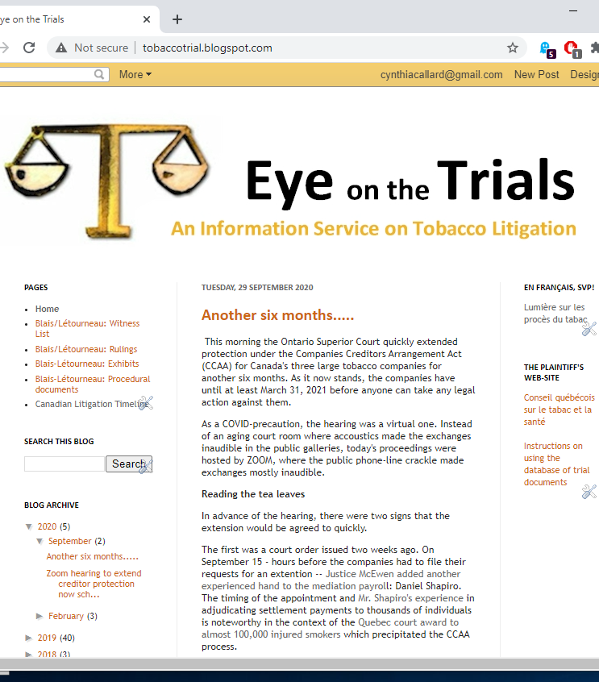
Thank you.
You can follow events at tobaccotrial.blogspot.ca contact: ccallard@smoke-free.ca
Notes:
25. As a community, we have not met often to talk about these lawsuits or their impact on our work. I would be so grateful if you would share with me now how you perceive these and what we should take on board from this experience as we move forward.

